Slide 1


Since 1997
Antech Consultants & Engineers
Electrical Consultants
Our Value System
About The Proprietor
Infrastructure & Core Team
Company Profile
Features
Engineering Services
Prestigious Projects
Prestigious Clients
Architects & Interiors
Electrical consultants
403, SATKAR, B/h. Swagat, Off C.G. Road,
Navrangpura, Ahmedabad: 380 009
Tele Fax : 2656 1881, 4893 4849
Cell: +91-98255 99021
Personal E-mail: nandish@antechconsultants.com
Office E-mail: antech@antechconsultants.com
Web Site: www.antechconsultants.com
Current Projects
Recently Completed Projects

Slide 2
Since 1997
Antech Consultants & Engineers
Electrical Consultants
Our Value System
We believe that
our clients should get benefit of maximum
discounts prevailing in the industry for various
Electrical equipments / products
and
Clients satisfaction is our prime objective
Company Profile
Our only expectations From All
Contractors, Suppliers & Equipment Manufacturers
are to provide Best Quality Work Material,
Full Technical Support and
Best Services to the Client
Always at Reasonable Prices
Electrical consultants
403, SATKAR, B/h. Swagat, Off C.G. Road,
Navrangpura, Ahmedabad: 380 009
Tele Fax : 2656 1881, 4893 4849,
Cell: +91-98255 99021
Personal E-mail: nandish@antechconsultants.com
Office E-mail: antech@antechconsultants.com
Web Site: www.antechconsultants.com

Slide 3
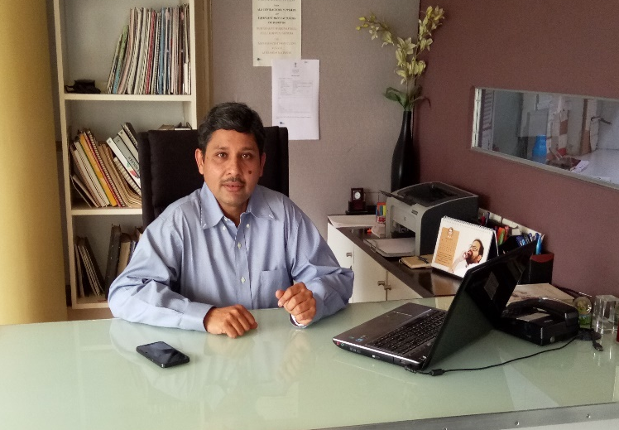
Since 1997
About The Proprietor
Professional Experience:
TWENTY SEVEN years of experience in Electrical Consultancy services including four years of work experience as an associate consulting engineer with M/s. Dalal Consultants & Engineers Limited, Ahmedabad.
Membership of Institutions:
Institution of Engineers (IE)
Indian Society of Lighting Engineers (ISLE)
Indian Society of Heating, Refrigerating & Air-conditioning Engineers (ISHRAE)
Academic Association:
Visiting faculty - Electrical Engineering with CEPT
School of Architecture
School of Building Science & Technology
School of Interior Design
Proprietor:-
Mr. Nandish Shah
B.E. Electrical (1992)
Birla Engineering College
Chartered Engineer
Valuer (Plant & Machinery)
PGD in Financial Management
PGD in Business Management

Slide 4
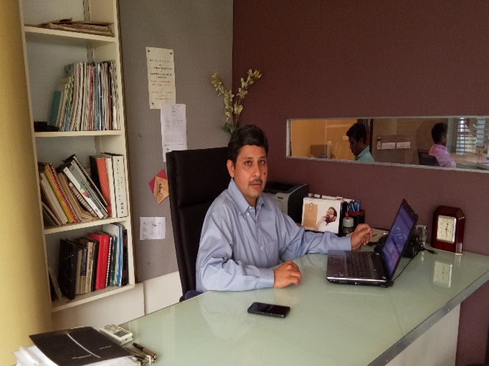
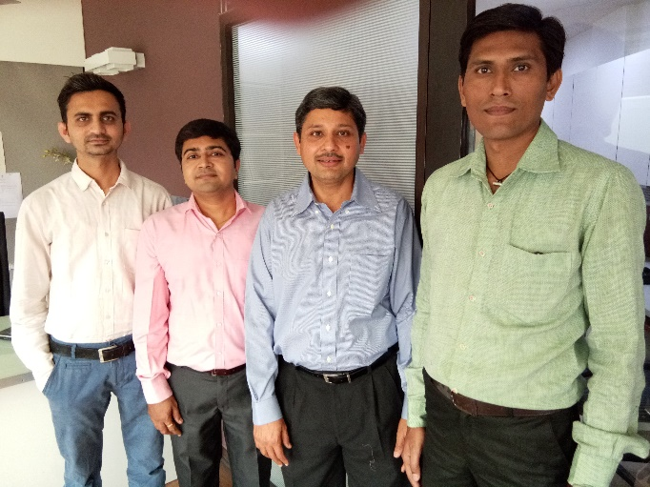
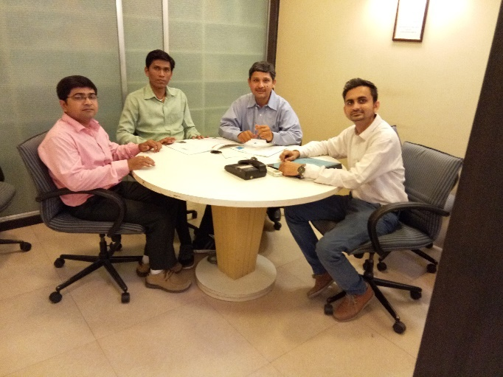
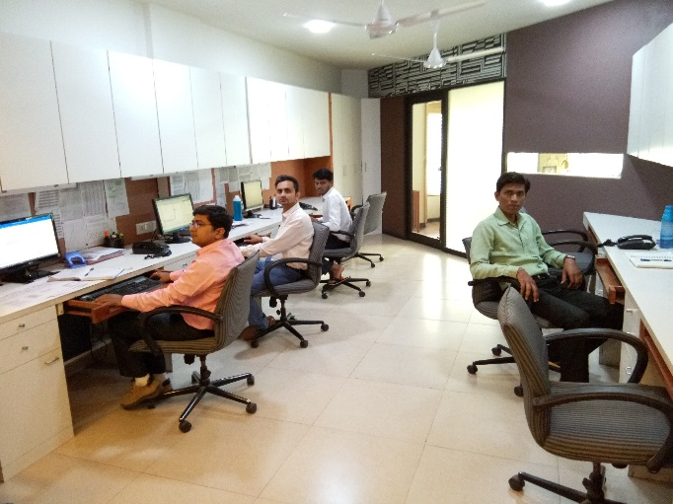
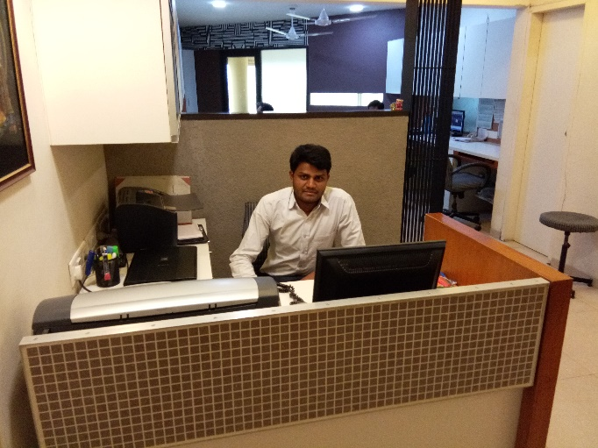
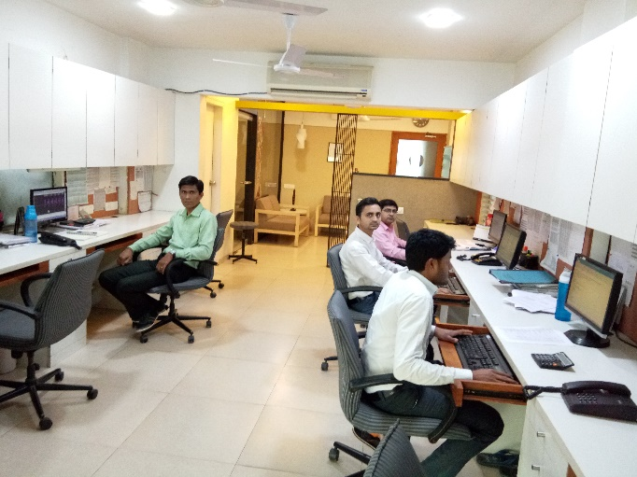
Since 1997
Office Infrastructure & Core Team

Slide 5
Since 1997
Features
Philosophy:
Our philosophy is to give customer value added services. In search of this we look at the project in totality. Our prime focus is not only optimizing implementation or running cost individually but the Life Cycle Cost.
Overview of Services:
We are in the field of Electrical Consultancy services for various Industrial Projects, Commercial Buildings, Hospitals, Residential projects, Hotels, Resorts, Multiplexes and Amusement Parks.
We provide basic and detailed engineering services in the field of Electrical right from estimation, planning, scheduling and designing. Services conform to all the relevant Indian and International standards.
Infrastructure:
ACE is equipped fully with trained technical personnel including Principal, Key Personnel, Design Engineers with required drafting & administrative support
TYPE OF PROJECTS:
Stadiums
Business & Exhibition Centres
Schools, Educational & Institutional Projects
Show rooms
Hospitals
Industrial & CNG station Projects
Corporate Offices , Banks & Complexes
Residential Schemes
Private Residences
Malls
Hotels & Resorts
Water Parks

Slide 6
Since 1997
Engineering Services
Designing & Planning of HT / LT Power System:
Electrical System Design calculations, Preparation of electrical single line diagrams, metering, protection and interlock schemes, Electrical Load Analysis, Identification of load center, Switchyard Layouts, Sub-station Designs and Electrical Equipment Layouts, Relay Co-ordination Schemes, Preparation of Power drawings and Cable routing networks for Sub-station, Utility area, Various production areas in the Plant Building, Cable tray and cable trench planning
Preparation of Cable Schedules
Designing of Emergency Power Supply System:
Designing of Diesel Generator ratings and Room Lay-outs, Emergency power Distribution schemes to feed Power to essential equipment, Manual or Auto changeover schemes for D.G. set and Electricity Board’s supply and associated Interlocking schemes
Designing of Power Factor Improvement System:
Designing of Capacitor requirements for the Electrical system
Automatic or Manual mode compensation as per the Project requirements
Designing of Harmonics system:
Harmonics Analysis, Harmonic studies & Active Harmonic Filter planning to keep Harmonics as per IEEE guidelines
Designing of Earthing System:
Designing of Earthing system
Preparation of Earthing Layouts
Designing of Lightning Protection System:
Designing of Lightning Protection system
Preparation of Lightning Protection Layout.
Designing of Lighting System:
Design of Lighting system and Lux level calculations for various areas. Preparation of Lighting drawings, Design and distribution schemes for Lighting, Selection of Light fixtures. Preparation of Bills of Quantity. External Lighting system design. Emergency Lighting System design
Designing of Low Voltage & UPS System:
CCTV camara & Access Control System
Public Address & Music System
Telephone , TV and Networking System
Fire Detection & Alarm System
Nurse Calling System
UPS Power distribution Scheme
Cost Estimates:
Preparation of Preliminary and final cost estimates for supply and installation of the entire Electrical system
Designing of Tender Documents for Electrical System:
Preparation of Technical specifications for various Electrical equipment / material. Preparation of Technical specifications for Erection, testing and Commissioning of Electrical Works. Preparation of Bills of Quantity.

Slide 7
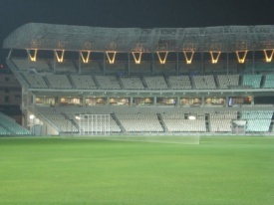
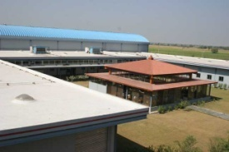
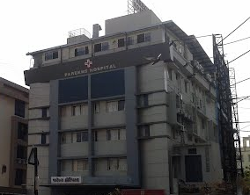
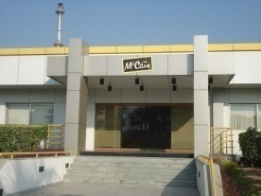
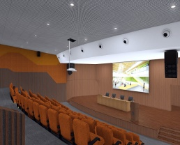
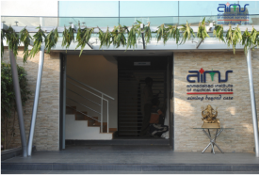
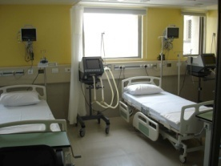
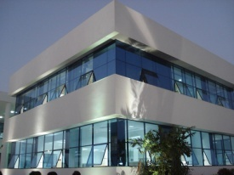
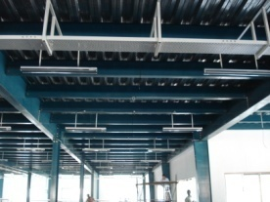
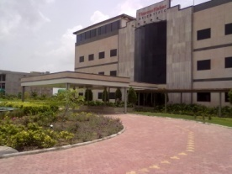
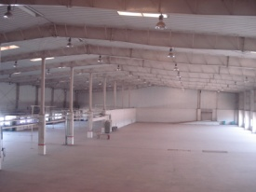
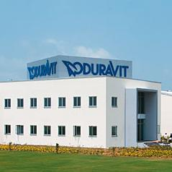
Since 1997
Prestigious Projects
Eden Gardens Stadium,
Kolkata
E+L
Bawla, Ahmedabad.
Parekhs Hospital
At Ahmedadad
NID, Auditorium
Gandhinagar.
AIMS Hospital
At Ahmedabad
Mc Cain Foods
Mehsana
Kloeckner Desma
Office Building
Odhav, Ahmedabad
CIMS Hospital
Sola, Ahmedabad
Artex Apperals
Ahmedabad
Mamata Machinery
Changodar, Ahmedabad
Thermofisher
SEZ, Ahmedabad
Duravit
Office Building
Tarapur, Gujarat

Slide 8

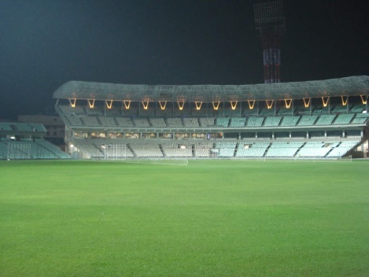
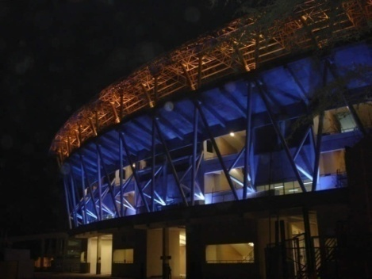
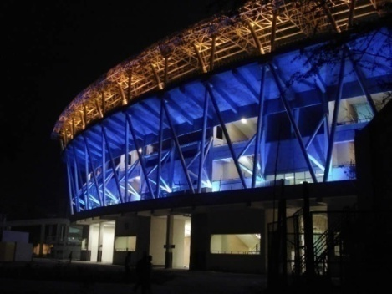
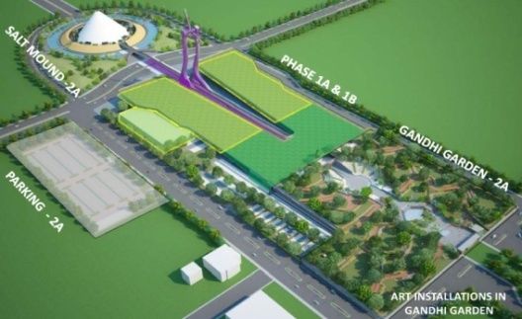
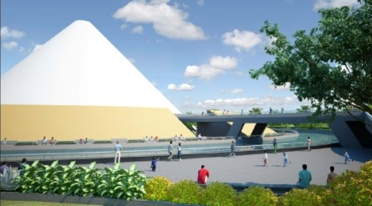
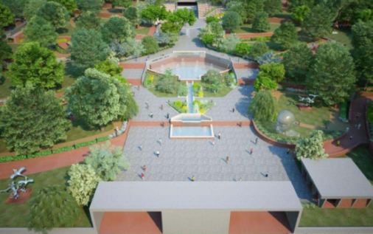
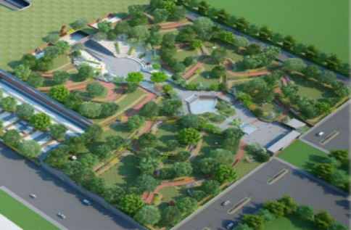
Since 1997
Prestigious Projects
Eden Gardens Stadium, Kolkata
Mahatma Mandir – Convention Center, Exhibition Center, Salt Mound & Gandhi Garden at Gandhi Nagar.

Slide 9

































































Since 1997
Prestigious Clients
RELIGIOUS
INDUSTRIALS
DEVELOPERS
HOSPITALS
CNG STATION
INDUSTRIALS

Slide 10

















































Since 1997
Prestigious Clients
COMMERCIALS
INSTITUTIONAL PROJECTS
HOTELS/BANQUETS/RESORTS

Slide 11
Our Association with Prestigious Architects,
Structural Consultants, Interiors & PMC
Since 1997
Abhikram / Panika
Apurva Amin Architects
ADS Architect Pvt. Ltd
Ami Engineers / Inscape
Anand Patel & Associates
AVN Architecture
Aakruti Architects
Ariane Thakore
Anandbhai Zaveri
Auctors Design
A New Dimensions
Associated Architects
Establish Designs
ONG&ONG Designs (I) Pvt. Ltd.
Opolis
Foot Prints E.A.R.T.H.
99 Studio
Gurdev Singh
Pranav Raiji
Placekinesis Associates
Patwa Associates
PCS Projects
Hiren Patel Architects
Himanshu Parikh
HM Architects
Indigo Architects
Iora Sudio
Indisign, Rajkot
Rahul Mehrotra Associates
Rathin Goghari Architects
Rounak Shah
Radhika Amin
R+R Architects
Bimal Mistry
Brijesh Contractor Associates
Bhumi Consultants
Jacobs Engineering India Pvt. Ltd.
Jinesh Doshi & Associates
JMA Design co. Pvt. Ltd.
SID, CEPT
SAK Design
Sukrut Designers
Shubhra Raje
Sanal Thathapuzha
Saptak Patel
SPASM Architects
CEPT
Creative Studio
Collaborative Design
Kakani Associates
Kallol Joshi
Kamal Mangaldas
Devendra Shah
Ducon Consultants Pvt. Ltd.
Desai & Patel Architects, Mumbai
De’s Design
Design Cell Architects
Design Square Architects
Design Module
Design Logic
Development 2020
Marsh & Associates. Inc. USA.
M S Consultants-Mohitbhai Parekh
U.K. Agency
UDG
Utpal Trivedi
Neelkanth Chhaya
Nilesh Kava
Neha Consultants
NK Shah
Varad Bhatt
Vee Design / Ad Mobel
VMS Engineering & Design services
Vogelkop Design & Development

Slide 12
Since 1997
Our Current Projects
Institutional & Educational Campuses:-
Adani Group Projects
CNG GAS STATIONS
Gujarat Univiersity :
Electrical Infrastructure planning
Computer Science Center
Tennis courts
GU SEC Building
GU Staff Quarters
Auctors Design
NID Ahmedabad & Gandhinagar
Bimal Mistry
IIM-AHD-CIIE BUILDING
A New Dimension
GAUDIUM School at Hyderabad
Kakani Associates
GIDM
GIDM Amphitheater
Auctors Design
Port Operation Buildings, Myanmar
(APSEZ, Canteen, Custom, POB)
Wilmar – Admin & Utility Building
Port Operation Building , Vizhinjam
Keystone Designs
Port User Building , Vizhinjam
Keystone Designs
Adani Finserve Offices
Across India
Think Gas,
Sabarmati Gas Limited (SGL) Gas,
IRM Energy,
Adani Gas Limited,
Gujarat Gas Limiited (GGL)
Auctors Design

Slide 13
Our Current Projects
Since 1997
Residential & Commercial Schemes:-
The Capital-II
51 Show Rooms
258 Ofifces
Neha Consultants
Gala HUB ANX-75 shops
Gala HUB-180 shops
99 Studio
One Panchvati-35 apartments
One Dwarka
13 Show Rooms
35 Offices
Galaxy Group-Rajkot
Indisign Architect – Rajkot
Shilpgram – 9
Iora Studio
Alpha Business Park
57-Shops
24-Show Rooms
ADS Architect Pvt. Ltd.
Sheetal West Park Residence-504
Sheetal – Business Clock
31-Show Rooms
242-Shops
Sheetal Varsha Group
Apurva Amin & Associates
Sanand Housing, Daffodils
Indigo Architect
Aadinath Residency
14 apartments
Creative Designs
World Trade Tower
376 offices
Sheetal West Park Imperia
63-Shops
93-Show Rooms
109-Offices
Sheetal – Indus Residence
Sheetal Varsha Group
HM Architects
S Cube
Associated Architects (I) P.Ltd.
7 Orchards
Design Logic

Slide 14
Since 1997
Our Current Projects
Private Residences:-
Shri. Jayantibhai Patel Residence
Brijesh Contractor Associates
Shri. Mayurbhai Vaghela Residence
Placekinesis Associates
Shri. Shambhubhai Parsana Residence
Rajkot
Design Square Architects
Shri. Rajvirsinh Jadeja Residence
Sukrut
Shri. Harenbhai Nawab Residence
R+R Architects
Omkar Vatika Bunglow, Umra
Shri. Pranavbhai Raiji
Saurabh Patel, Farm House
Design Logic
Commercial Complex, Offices;
Malls, Hotels & Resorts
Smt. Nehaben Residence
Shri. Ruchirbhai Teli
Shri. Shalinbhai Mehta
Dr. Ketubhai Parekh
Smt.Shivaniben Desai
Shri Hirenbhai Patel Residence
HPA Atchitect
Chhaya Residence
Saptak Patel
Shri. Munirbhai Shah Residence
Design Module
Shri. Babubhai Jamnadas Patel
Residence,
Vegelkop Design & Development
Shri. Shyamjibhai. Adipur,
Shah House,
Indigo Architects
Jindal House
SPASM Architects
Westport, Ahmedabd
HM Architect
Shankus Water Park, Mehsana
Devendra Shah
Kalhaar Blues & Green Club & Hotel
525000 Sq. Ft.
Marsh & Associates. Inc. USA.
Wild Life Resort, at Tipeshwar.
Ariane Thakore
IPS Mess
Jal Bhavan
Auctors Design
Offline Park
Collaborative Design

Slide 15
Since 1997
Our Recently Completed Projects
Religious :-
Institutional Projects:-
Mahatma Mandir – Convention centre,
Exhibition halls, Gandhi Garden, Salt mound at Gandhinagar
CEPT / VMS Engineering & Design services
Shantivan, Museum & Memorial for Cadila
Pharma., Foot Print E.A.R.T.H
Vadnagar Museum, CEPT
JMA Design Co.
Darpana / Natrani Studio
Indigo Architects
Shaleen Radiation Centre
Radiation centre with 2 Linac rooms
Chaudhary Hospital, at Udaipur
Bimal Mistry, Architect & Associates
Kaizen Hospital for
Dr. Sanjivbhai Haribhakti
Bimal Mistry
AIMS Hospital
Ami Engineers / Inscape
Neonatal Hospital for Dr. Ashish Mehta
Manoramya
Parekhs Hospital at Ahmedabad
Alap Kamdar
Kothari Onco Surgical Hospital,
Maninagar.
Hospital for Dr. Hemen Jaju
Appolo CVHF Pvt. Ltd.,
Kakani Associates
Raptim Lab
JMA Design
Shrimad Rajchandra Mission,
Dharampur
Shrimad Rajchandra Mission,
Idar
Shrimad Rajchandra Mission,
Vadva
Shri Jagannath Temple,
Ahmedabad.
Stadiums:-
Eden Garden Stadium at Kolkata
VMS Engineering & Design services
Hospitals:-
CIMS Hospital
Expansion at Ahmedabad
Kakani Associates / Himanshu Parikh
HCG Hospital at Baroda,
90,000 sq. ft area
Radiation centre with 2 Linac rooms
Hiren Patel

Slide 16
Since 1997
Our Recently Completed Projects
Industrials:-
Amson Biomed
Makers Lab
Inscape
Exelon Multipack
M S Consultants
TARA Paints & Chemicals
Dry Fruit Factory
Rathin Goghari
Online Print & Pack Pvt. Ltd.
GEO Source at Dholka
Nayon Exports at Narol
Precision Technoplast at Gomtipur
SVP Packaging Pvt. Ltd., at Palghar, Thane
Desai & Patel architects, Mumbai
Kirloskar Brothers Ltd. at Sanand
Ducon Consultants Pvt. Ltd.
Kloeckner Desma at Odhav
Ducon Consultants Pvt. Ltd.
Erhardt + Leimer (India) Pvt. Ltd. at Changodar
Kamal Mangaldas/ Devendra Shah
Mamata Machinery at Changodar
Ducon Consultants Pvt. Ltd.
Paras Webcoat Pvt. Ltd., Sanand
Artex Apparels at Ahmedabad
Devendra Shah
Thermo - Fisher Scientific at S.E.Z. Ahmedabad
Kamal Mangaldas /Devendra Shah
Molex Mafatlal Micron Pvt. Ltd.
at Gandhinagar
McCain Foods India Pvt. Ltd.
at Mehsana
VMS Engineering & Design services
Mamata Hydco at Chhatral
Ducon Consultants Pvt. Ltd.
Corrtech International Pvt. Ltd.
At Changodar
Ducon Consultants Pvt. Ltd.
Yamir Packaging Pvt. Ltd.
at Ankleshwar
Dilip Soni
Inspiron Engineering (P) Ltd.
at Odhav
Gentek Technology India (P) Ltd. at Gandhinagar
Kamal Mangaldas/ Devendra Shah
A-one Chemicals at Ankleshwar
Ducon Consultants Pvt. Ltd.
Sandesh press-
Ahmedabad, Baroda,
Rajkot & Surat
Vee Design / Ad Mobel
Jason Dekor Ltd, Karjan
TKT high Tech Cast,Sanand
Ducon Consultants Pvt. Ltd.
Kheria Autocomp at Nano Vendor park, Sanand
Ducon Consultants Pvt. Ltd.
Westlin Recycler Pvt. Ltd. Changodar
Ducon Consultants Pvt. Ltd.
Sumip Composite at Changodar
Ducon Consultants Pvt. Ltd.
Krupa paints at Changodar
Ducon Consultants Pvt. Ltd.
Marck Parenterals (I) Ltd.
at Matar

Slide 17
Since 1997
Our Recently Completed Projects
Industrials:-
Vishal Fabrics Pvt. Ltd.
at Narol
Ducon Consultants Pvt. Ltd.
Rutu Autogas at S.G. road
Ducon Consultants Pvt. Ltd.
Rohan Automotive at Changodar
Ducon Consultants Pvt. Ltd.
Dairy Den Engineering (P)Ltd. At Gandhinagar
Schott Glass (I) Ltd. At Jambusar
Dinesh Polyber Ltd.
Photokina Chemicals Pvt. Ltd. at Changodar
Ducon Consultants Pvt. Ltd
Parekh Marine agencies at Kandla
L.J. Purani & Associates
Sabarmati Paper mills at Aagload
Plastic Products Engineering, Narol
Ducon Consultants Pvt. Ltd.
Wood Star India Pvt. Ltd. at Sanand
Ducon Consultants Pvt. Ltd.
Transformers & Rectifiers (I) Ltd.
Pradip Makhijani
Schools & Educational Campuses:-
Zebar School for Children
CEPT Campus
Aakruti Architects
AIS School
Rathin Goghari
Anand Niketan School at Gandinagar
Kakani Associates
Divine Child School, Adalaj
Aparna School at Odisha
Shubra Raje
MG Science College
AMI Engineers.
HB Kapadia School at Chhatral
Indigo Architects
Udgam school at Ahmedabad
Anand Niketan School at Shilaj & Ambli
Kakani Associates
Rachna School – Abhikram / Panika
UDCT – DBT – ICT , Mumbai
JD Associates
College at Gadh, Palanpur
Kallol Joshi
TODDEN Pre School
Rathin Goghari

Slide 18
Since 1997
Our Recently Completed Projects
Corporate Complex & Show Rooms:-
One 42, 170 shops/offices
AMAYA Properties LLP.
Aarna Service Apartments
Kiran Gandhi
State of Art Exhibition Centre
Shri. Shambhubhai Parsana Office
At Rajkot
Desig Square Arechitects
E+L Office
Devendra Shah
James Mathew Offce
Radhika Amin
Shri Rahulbhai Parekh
Rounak Shah
Aegis Logistics at Mumbai
Jinesh Doshi & Associates
IFCI , at Ahmedabad
Rathin Goghari
Riddhi Siddhi Arcade at Ahmedabad
Hiren Patel Architects
Audi, at Ahmedabad
Zarir Mullan
M/s. Agrawal Infracon
Satyem Joshi, Zenith Designer
Hitech Elastomers at Ahmedabad
Endless Ideas
Phoenix IT Solutions Ltd. at Vizag
Kakani Associates
A B Jewels at Shivranjani, Ahmedabad
Ami Engineers / Inscape
Laxmi Jewellers
Vee Design / Ad Mobel
Sangam Spinners at Bhilwara
Vee Design / Ad Mobel
Montecresto Party Plot
Hiren Patel
HMR Commercial complex at Hyderabad
Kakani Associates
S N Hotel – Collaborative Design
Deewanji ni Haveli, City Heritage Centre
Hardik Patel

Slide 19
Since 1997
Our Recently Completed Projects
Corporate Complex & Show Rooms:-
Sanskruti at Ahmedabad
Avani Enterprise
Duravit India Pvt. Ltd. At Tarapur
VMS Engineering & Design services
SKF Technologies (I) Pvt. Ltd. At Bawla
Hiren Patel
Sahakari Khand Udyog Mandal, Gandevi
VMS Engineering & Design services
Ishi Systems
Ami Engineers / Inscape
Rajesh Nuwal & Hemant Panpalia, Mumbai
Marck Parenterals (I) Ltd.
Shri. Bharatbhai - Ami Engineers / Inscape
Research & Development center at Surat
Devendra Shah
Amazone II, at Ahmedabad - Dilip Soni
State EOC building for GIDM
Jacobs Engineering India Pvt. Ltd.
Dandi Library & Dandi Heritage corridor
CEPT
Stone Artisan park
at Ambaji & Dhanghadra
SID, CEPT
Sabic Research & Technology Pvt. Ltd. at Baroda
Aarvee Denim at Ahmedabad
Vee Design / Ad Mobel
State ERC building for GIDM
Jacobs Engineering India Pvt. Ltd
Paragraph Business Centre
Unn, Panjrapole
Indigo Architect

Slide 20
Since 1997
Our Recently Completed Projects
Residencial Schemes:-
One 49 Residence-103 apartments
AMAYA Properties LLP.
ONG&ONG Designs (I) Pvt. Ltd.
Casa Vyoma –
Ajmera & Sheetal Varsha Group –
576 apartments
Hiren Patel Architects
Gala Glory-154 Apartments
Hiren Patel
Gala Celestia-217 Apartments
AVN Architecture
Gala Eternia & Empire –
224 Apartments, 87 Shops &
340 Offices.
ADS Architect Pvt. Ltd
Sheetal Aqua Residence-140 Apartments
Sheetal Varsha Group
Apurva Amin & Associates
South Bopal Trade Cneter-
146 shops
99 Studio
Park Heights-
100 apatments & 24 shops
Venus Group
AVN Architecture
Avaneesh Heights
96 apartments & 18 shops
Creative Designs
Brick Homes -16 apartments
Olive Group
Apurva Amin & Associates
78@Gokuldham - Shaan Zaveri –
192 apartments at Sanand
Amaya Properties LLP
Satyamev Vista – 360 apartments
Hiren Patel Architects
Anantshiv Residency
Hami Designs
Sukrut Repose at Bopal
Hiren Patel Architects
Adani Power Township at Nagpur
Hiren Patel
Pacifica housing – Meadows
Kamal Mangaldas – Devendra Shah
Arihant Mangalam at Ahmedabad
Mohit Gajjar
Aryaman bungalows – Saumya construction
Kamal Mangaldas/ Devendra Shah
Frangi Pani at Goraj
Altan Fields 56 Villas, Sanand
Sukrut

Slide 21
Since 1997
Our Recently Completed Projects
Private Residences:-
Shri. Haresh Panchani, at Surat
Hiren Patel Architects
Shri Kamleshbhai Jogani
Apurva Amin & Associates
Shri Purav & Niral Shah
Kakani Associates
Niral Shah
Kakani Associates
Shri. Sanjay Mangal
Kakani Associates
Smt Sheelaben Harivallabhdas
Abhikram / Panika
Shri Ananadbhai - Iora Studio
Shri. Asitbhai Residence
U. K. Agency
Shri Sujalbhai
Vee Design / Ad Mobel
Shri Sodaniji – Sangam Group at Bhilwara
Vee Design / Ad Mobel
Shri Sanjaybhai Lalbhai – Lalbaug House
Rahul Mehrotra Associates
Shri Samirbhai Mistry
Apurva Amin & Associates
Shri P.R. Kankariya at Shahibaug
Abhikram / Panika
S N Residence
Collaborative Design
Dr. Dimple Parekh
Anand Patel Associates
Shri Rikinbhai & Anishbhai Dalal
Apurva Amin & Associates / Nilesh Kava
Shri Naimeshbhai at Gondal
Hiren Patel Architects
Shri Pankajbhai Desai – Wagh Bakri
Hiren Patel Architects
Shri Anujbhai Parikh
Indigo Architects
Shri. Keyurbhai Gandhi
Abhikram / Panika
Shri. Ajaybhai Thakkar –
Rathin Goghari
Shri. Pankajbhai Mehta - Mistry Associates
Shri. Swapnilbhai Shah
Ad Mobel / Anisha Modi
Shri Maulinbhai Shah - Mukul Sheth
Shri Ketanbhai / Jitendrabhai
Amee Engineers / Inscape
Shri Pareshbhai & Shilpaben Dave
Sukrut Designers
Shri Falgunbhai Patel – SANDESH
Apurva Amin & associates
Shri. Samirbhai Sarabhai
Devendra Shah
Shri. Yogeshbhai Mahadevia
Shri Mahavir Jain Aradhana Kendra at Koba
Ducon Consultants Pvt. Ltd.
Craft park at Bhuj
Neelkanth Chhaya
Rannde Home
Foot Print Earth

Slide 22
Since 1997
Our Recently Completed Projects
Private Residences:-
Shri Nayanbhai Thakkar
Vee Design / Ad Mobel
Shri Chiragbhai & Radhikaben - Sukrut
Shri. Ghanshyambhai & Natubhai Patel
Divyesh Desai & associates
Shri. Rajivbhai Lalbhai
Ara Associates
Dr. Ashishbhai Mehta Residence
Apurva Amin & Associates
Shri. Asheeshbhai Agrawal
Shri. Mehul Desai, at Valsad
Hiren Patel Architects
Shri. Jigneshbhai Shah Residence
Inscape

Slide 23
Since 1997
Our Recently Completed Projects
Adani Group Projects
Malls, Hotels & Resorts:-
Eulogia Inn – De’s Design
HCG Haveli,
Sanal Thathapuzha
Himalaya Mall at Bhavnagar,
Mehsana & Vadaj, Mohit Gajjar
Bikaner Palace at Abu
Sukrut – Amalaben Shah
Hotel Shiv at Kandagra
Zenn Architects & Interior
House of CG for Shri Abhay Mangaldas
Kamal Mangaldas
Shopping mall for Lake city mall at Thane
SMPS-Bombay/OS2 Architects
Mall & Multiplex for Bengal Sristi at Durgapur
SMPS-Bombay/OS2 Architects
Rajpath Club limited at Ahmedabad
Devendra Shah
Black Buck resorts at Velavadar
Karishma Desai
Hotel Shiv Nautica at Mundra
The Grand Shiv Hotel at Gandhidham
Vee Design / Ad Mobel
Damanganga Valley resort at Silvassa
Kamal Mangaldas/ Devendra Shah
Holiday Resorts at Gandhidham
Devendra Shah
Swapna Srushti Club, Grambharti
Foot Print E.A.R.T.H
Rang Nivas Palace, Udaipur
Abhikram
Wilmar – Bachelor’s Hostel, Mundra
Shantivan Colony, Mundra
Adani Office, Chennai.
Port Operation Building (CT-4), Mundra; Keystone Designs
Port Operation Building, Dahej; Keystone Designs
MITAP Central Kitchen, Mundra
Port Operation Building, Ennore; Establish Designs
SS-6 Dhamra
Establish Designs
Mundra Solar Techno Park
Security Cabin Wing – A
Security Cabin Wing – B
Dispensary
Fire Station
Canteen Building
Admin Building
R & D Center
Thanks……

